Slide 1

Project Execution Kick-Off
0038210 WV Foster Care; SNS
10/9/2019

Slide 2
Housekeeping
Please mute your lines if you are not speaking to avoid background noise. Please announce yourself and your area before speaking. Please do not place the call on hold.

Slide 3

Agenda
Executive Summary & Scope
Project Team
Impacted Systems & Deliverables
Conceptual Solution Design
Conceptual Architecture Diagram
Project Delivery Model
High-Level Project Timeline
Risks & Issues
Next Steps
Project ID and Websites

Slide 4
Executive Summary
West Virginia’s foster care population has continued to increase over the past several years due to the opioid epidemic facing the state, with 85% of cases involving substance abuse. There is a significant need to better help those families in crisis and reduce the number of children removed from their home. For those that have already been subjected to this event, the Department must implement a strategy to help better coordinate the care of those members and make sure they are receiving all of the necessary services available, in hopes that reunification may occur. DHHR is looking to transition the WV Foster Care and Adoption Assistance population into a managed care or managed care-like environment. This project will be split into three (3) parts – SNS Requested Delivery Date: 12/13/19 Go Live: 1/1/20 Foundational Requested Delivery Date: 12/13/19 Go Live: 1/1/20 YouthRap/Heath Passport Requested Delivery Date: tbd Go Live: tbd

Slide 5
Scope
Vendor Management – Regional Child Welfare Organizations/SkyGen
Enrollment file extracts
E2E Testing
Coordination of Services/Care
Case Management/Intensive Care Management
ACMP/WV HIN/CareCompass testing?
WGS Case/Group structure changes – new MBU/new group (product)
Provider Network Adequacy
Regulatory Reporting
WGS Claims, not FACETS
Ensure new MBU is included in any non-foster care specific reports
Net new reports
Socially Necessary Services
LCT build and links to FACTS/IES/WV BMS/UniCare
Utilization Management
Coordination w/Educational Systems
Quality monitoring of EPSDT testing
Coordination with Child Protective Services
Crisis Response
Establish relationship with Judicial system
Collaboration with State pharmacy program/State Case Workers
Process support and reporting around patient-centered medical homes (Tara Fike leads Health Homes in WV)
Discharge planning coordination and collaboration
Member Outreach & Education
Provider Outreach & Education
Benefits/Care Coordination
Member Communications
Contracting
Contracts w/all currently enrolled providers under the State’s fee-for-service (FFS) Medicaid program and those providers contracted with the Bureau for Children and Families (BCF) for social services
Provider Incentives
HEDIS Measures
Member portal access to medical records/appeals/HIN, etc.
Provider portal access to medical records/appeals/HIN, etc.
Incorporating SDoH into care plans
Collaboration with Bureau of Public Health – WV Home Visitation Program
Engagement with community-based child welfare organizations
Development and Reporting of Provider Profile Report Cards
Automation?
Human Capital – HR/L&D/TA
Key Staff hiring required
Look to workforce management/staffing ratios for all areas to account for new population
VASs
NEMT
Telehealth, tele-monitoring
Possible vendor procurement

Slide 6
Out of Scope
WGS Case/Group Structure Changes
ID cards are not in scope for SNS
Provider outreach and education
Billing
Providers to bill directly

Slide 7
Project Leadership
Project Leadership
Initiative Owner (IO): Tadd Haynes
Initiative Delivery Owner (IDO):
Robert Schweers
Business Core Team
Business Owner: Manny Arisso
Project Lead:
Mikenna Watterson
Project Manger:
SherieAnn Dixon
Project Manger:
Susan Hernandez
Project Manager:
Steve Melville
IT Execution Core Team
Delivery Lead:
Laxmi Sharma
Delivery Manager:
Mal Herrera
Solution Lead/Architect:
Bahar Chathambally
IT Account Manager:
Leslie Caluya
LCT Architect:
Lonnie Watson

Slide 8
Impacted Systems*
Corporate, Care & Consumer Engagement (CCCE)
Digital Technologies
Anthem Care Management Platform (ACMP)
FileNet
ICR (Interactive Care Reviewer)
NextGen PEGA Appeals System
GBD Member Portal
Government Business Division IT
GBD MACESS
GBD Provider Portal / Availity
SSB – Medicaid DW Data Solutions & Reporting
SSB – Medicaid DW Encounter
WGS Claims - GBD
WGS Membership & Billing - GBS
Commercial Claims Technology
Commercial Product, Sales & Underwriting
IT Clinical Analytics
WGS Provider
EBA
eWPD
Strategic Provider System (SPS)
Health Care Analytics
Other System(s)
HCA EDW
LCT/ASCA
*The impact to these systems will be reviewed by the Solution Lead on the next slides

Slide 9
Impacted Systems Point of Contacts
Impacted system | Point of Contact or Effort Estimator
SSB - Medicaid DW Data Solutions and Reporting | Alyssa Brown (Scrum Master)
WGS Claims - GBD (Government Business Division) | Saritha Jayakumar (Technical Lead) CN Venkatesha (SIT)
WGS Membership & Billing - GBD | Bahar Chathambally (Solution Lead)
WGS Provider | Murugan Pavadai Muthukumar Jayasankar
HCA | Aruna Pantham (Regression Analyst) Ajay Reddy Maram (EDW TDM)
IT Digital / SOA EHUB | Balraj Singh
Member 360 and Hiebus | Brandon Raab
HCM / CMOS | Rebecca Rossi Bhavani Parakala
Anthem Care Management Platform (ACMP) | Dinakar Meda Rikard Ndreu Sathiya Gopalakrishnan Srinivasan Thirumaran Sudharma Rajan Archanadevi Prabu Krishnamurthy
EBA | EBADiscovery@wellpoint.com
eWPD | Scott Eigner Frank Shaw Anoop Philip Shinothomas George Venkadachalam Sathya Anand Seshaiyer

Slide 10
Impacted Systems Point of Contacts – cont.
Impacted system | Point of Contact or Effort Estimator
FileNet | enterprisecontentmanagement-ECM@anthem.com
GBD MACESS | William D. Nipper
GBD Member Portal | Kimberly Z. Hammett Karen Palmer Jae Pickard
GBD Provider Portal / Availity | Sathish Kothamasa Dan Scalfaro Holly Henry
ICR (Interactive Care Reviewer) | Prabhpreet Gill Chander S. Chaudhary Hari P. Boddani Prathyusha Dasari Amalia VanMatre Sharada Chandran
NextGen PEGA Appeals System | Rohit K. Guttula
SSB - Medicaid DW Encounter | Chuck Marshburn Jason Tesoro Norman Lyster, Abhilash Krishnan Nair Chenthil Vanamamalai
Strategic Provider System (SPS) | DL-ProviderFoundationsEstimation

Slide 11
Impacted Systems & Deliverables
Area | Deliverable | Target Delivery Date*
Corporate, Care & Consumer Engagement (CCCE) | tbd | 12/13/19
Commercial Product, Sales & Underwriting | tbd | 12/13/19
Commercial Claims Technology | tbd | 12/13/19
Digital Technologies | tbd | 12/13/19
Government Business Division (GBD) | tbd | 12/13/19
IT Clinical Analytics | tbd | 12/13/19
Health Care Analytics | tbd | 12/13/19
LCT/ASCA | tbd | 12/13/19
*Target Delivery Date is the requested delivery date per the release calendar. Further details to be developed by IT Teams. Code Freeze begins 12/17/19.

Slide 12
Conceptual Solution Design
WGS Membership and Billing – CSD
As the membership system, need to be able to ensure a member can be identified as being a part of the West Virginia Foster Care program, so that the system can enroll them accurately (New MBU, Product line, Case and Groups will be required).
eWPD, EBA
As the Product Configuration team, need to create new Benefit Contract Code for all West Virginia Foster Care program, so that the product/plan is accurate.
WGS Provider, SPS
As Provider Configuration team, need to ensure the SNS referral providers are used for West Virginia Foster Care providers as PCPs, so that providers are identified appropriately. As Anthem, need to be able to accept and store monthly provider status/summaries sent from the provider/s of services
LCT/ASCA
Accept SNS requests., provider authorizations and send out approval/denial of referrals to FACTS
Member Portal
As the Member Portal team, need to ensure a member is able to view, print, and download the West Virginia Foster Care products benefits

Slide 13
Conceptual Solution Design
ACMP
As the Care Management system, need to ensure product authorizations and referrals process uses the West Virginia Foster Care , so authorizations and referrals are accurate.
Care Management system need to be able to send/ receive referral approval/denial status back to FACTS WV State system.
Care Management need to be able to accept additional information from the Case Workers so we can incorporate into our Care Management for existing members or members that become a member in the future.
Next Gen PEGA Appeals
Need to be able to handle WV Foster Care Program Grievance and Appeals for the WV Foster Care program as we do for other services
Clarity/Welcome Kits Processing
As the ID Card team, need to ensure to display all required fields related to West Virginia Foster Care so that the ID card is accurate (Copay??).
CCB-West, Solution Central
As the Customer Service tool(s), need to ensure tools are updated to accurately display eligibility, benefits, and claims information related to West Virginia Foster Care, so that Customer Service Reps obtain accurate information.

Slide 14
Conceptual Solution Design
SSB – DW
As Anthem Data Analytics, need to ensure that we can crosswalk FACTS case id to our internal indicator/s so that data can be traced to our members
FileNet
As Anthem, we need to be able to accept and store Individual Education Plans (IEP) from the schools.
Hiebus
Needs to feeding data to Hiebus to be displayed on Member360 and Patient 360 in the LPR (longitudinal patient record) for viewing. Once in Hiebus it is also accessible to the nurses via Care Compass

Slide 15
Conceptual Architecture Diagram

Slide 16
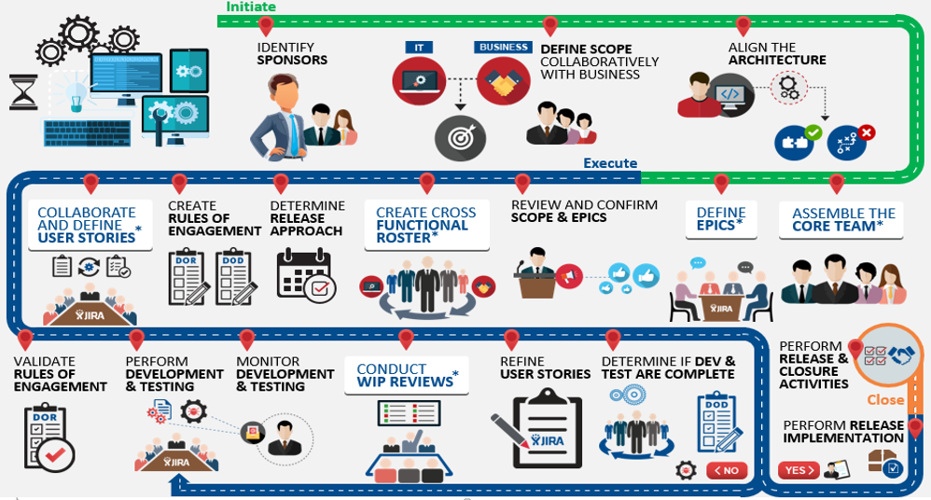
Project Delivery Model

Slide 17
Target Milestone Dates
Execution Kickoff
10/9/19
Alignment for Lower Environments
<tbd>
Execution Checkpoint 11/9/19
SIT Complete 11/14/19
UAT Complete 12/6/19
IT Dev Complete <tbd>
Requested Delivery 12/13/19
Go-Live 1/1/20
Code Freeze Window
~12/17/19 thru ~1/4/20

Slide 18
Risks
Requested Delivery Date is 12/13/19. This date is aligned with the IT Release calendar. This will reduce the execution/delivery time.
IT Teams are not yet identified. Scrum Teams are not in place.
Foundational Services scope is not clear. IT deliverables are not identified. As per IMO, the requirements may not be final until 10/18/19.
Risk Management Plan
Known Issues
As of 10/8/19, award notification has not been communicated. While the award is not communicated, Anthem remains in a blackout period where no questions can be posed to the state.
As of 10/9/19, project is submitted for approval to Execution. We are waiting on approval.

Slide 19
Next Steps
Description | Ownership | Notes
Receive Confirmation of RFP | IMO | This may not occur until 10/15/19
Receive Confirmation of Funding Approval | IT-CAM
Finalize HLBR’s | IMO | This applies to foundational; SNS HLBR’s were completed by initiation management
Breakdown HLBR’s into detailed business requirements | IMO
SNS Solution Overview for Business/IT Teams | IT-CAM, DMs, Solution Architect | DMs to schedule, IT-CAM to lead
Develop Dependency Matrix Log | IT-CAM, DMs, Solution Architect, IT Team Leads | Will help define critical path & delivery timeline
Creation of User Stories & LOEs based upon detailed business requirements | Dev Teams | To be completed once IMO provides detailed business requirements
Develop Team Roster – roles & responsibilities | DMs
Develop Communication Plan | DMs
Further Define Risk Management Plan | DMs | Utilize IMO Risk Management Plan

Slide 20
Next Steps - continued
Description | Ownership | Notes
Spin Up Individual Team Meetings | DMs | Meetings will be will each development team (once identified) to make sure there are no pending questions
Schedule weekly status meeting w/IT Leads | DMs
Creation of Status Report/APM Score Card | DMs
Develop SNS Delivery Plan | IT-CAM, DMs, IDO, Solution Architect
Develop development plan w/LCT | IT-CAM, DMs, IDO, Solution Architect

Slide 21
Communication Plan (Meetings)*
Work Streams | Meeting Name | Agenda | Participants | Ownership | Frequency | Facilitator/Scribe | Meeting Notes Sender
SNS | Status Meeting (Business and IT) | Review Overall Status (Business, IT) | DMs, IMO, Solution Architect, IT Team Leads, POs, Key Stakeholders | DM | Weekly | DM | DM
SNS | Risks & Decision Log Review | Review Risks & Decisions to be made | DM, SM, Tech. Lead, PO, SA(s) | DM | Weekly | DM | DM
SNS | SNS Solution Overview | Review overarching solution | DMs, IT-CAM, Solution Architect, IT Team Leads, Dev Teams | DM | 10/17/19 | DM | DM
SNS | Individual Technical Team Sessions | Project Delivery & Planning | DMs, Solution Architect, IT Team Leads, Dev Teams | DM | Initial meeting to be schedule. Future sessions as needed | DM | DM
*Further details to be developed with IT Teams

Slide 22
Communication Plan (Reports)*
Work Streams | Report Name | Ownership | Frequency | Distribution Method | Contents/Metrics | Contributors | Recipient of Report
Project | APM Score Card | DM | Weekly | Publish/Email | IT Status, Achievements, Key Milestone Dates, Risks, Mitigation Steps | DMs, IMO, IT POCs | Key Stakeholders
Project | Business Report Card | IMO | Weekly | Publish/Email | Business Activities, Achievements, Key Milestone Dates, Risks, Mitigation Steps | IMO, DMs | Key Stakeholders
*Further details to be developed with IT Teams

Slide 23
Project IDs and Websites
WAVE ID: 01338
APM ID: 0036877
Funding is still being confirmed as of 10/8/19
CWI Site: Central Work Intake (CWI) Link
Project SharePoint Site: SharePoint Site (IMO)
Initiation SharePoint Site: SharePoint Site (Initiation)

Slide 24
Questions

